Slide 1
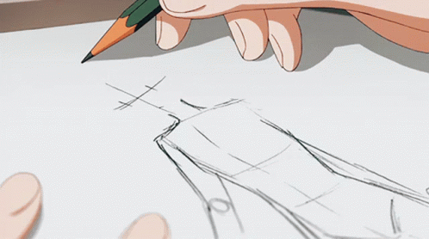
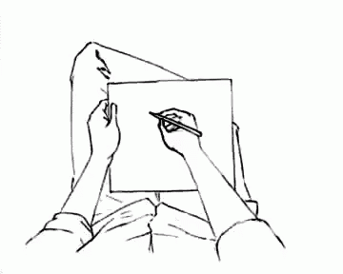
Art Bible
Template
Anna M.

Slide 2
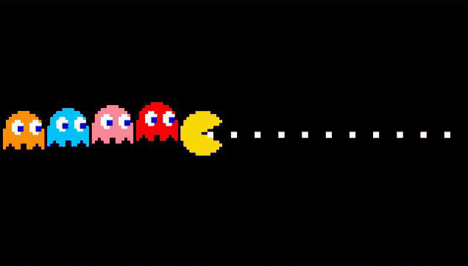
This template is based on Pac Man, 1980 maze action video game. Feel free to substitute the text and images for your own game.

Slide 3
Group Introduction
About:
Game Name -
Group Name –
Members –
Short introduction of the game -
Artists: Name Surname, Name Surname…

Slide 4
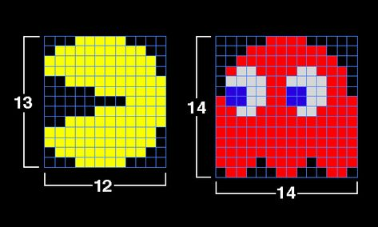
1. Art Guidelines
The art should follow a set of specific guidelines, that way we can assure the art of our game is consistent and each member of the team can implement new art following this guidelines:
Pixel art style.
Bright colours, no shadows.
This picture explains the visual direction of the game.

Slide 5
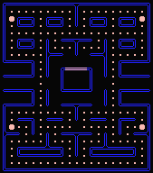
2. Camera view
The game has to be seen from top view, that way the player can identify assets easily and feel more attracted to the characters.

Slide 6
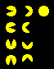
3. Characters
The player controls the eponymous character through an enclosed maze. The objective of the game is to eat all of the dots placed in the maze while avoiding four colored ghosts.

Slide 7
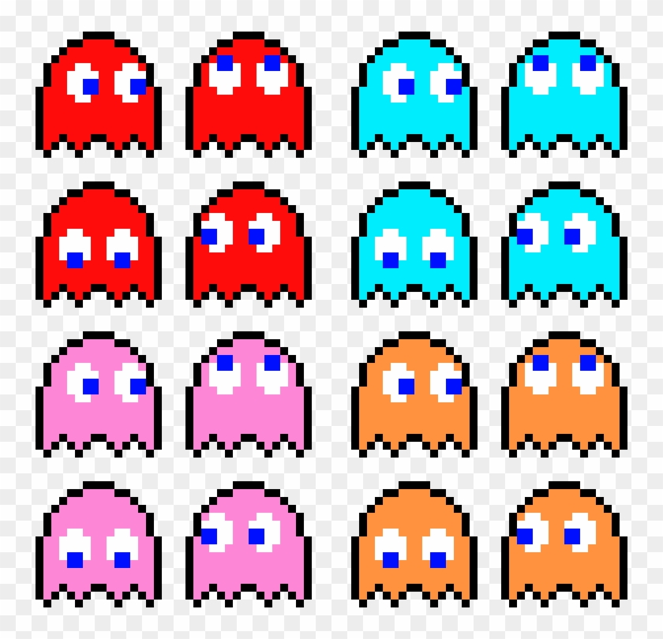
4. Enemies
Blinky, Pinky, Inky and Clyde are a quartet of characters from the Pac-Man.
Each has a different mechanic.
The differences between the ghosts are their methods of selecting target tiles in Chase and Scatter modes.

Slide 8
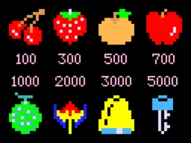
5. Items
Items in the game have to follow the same guidelines as everything else: The items have pixel art style, with very colorful colours, and easy to understand for the player.

Slide 9
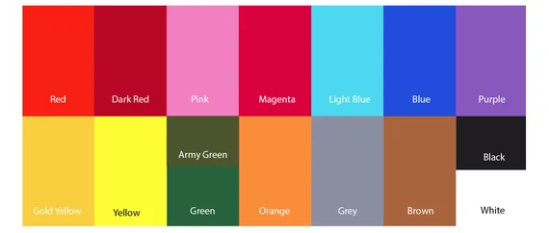
6. Color palette
We must give the player a sense of adrenaline, with some elements and colors that remind of it. With this, game is more lively, enjoyable to watch. For the pacman color palette, check the following:

Slide 10
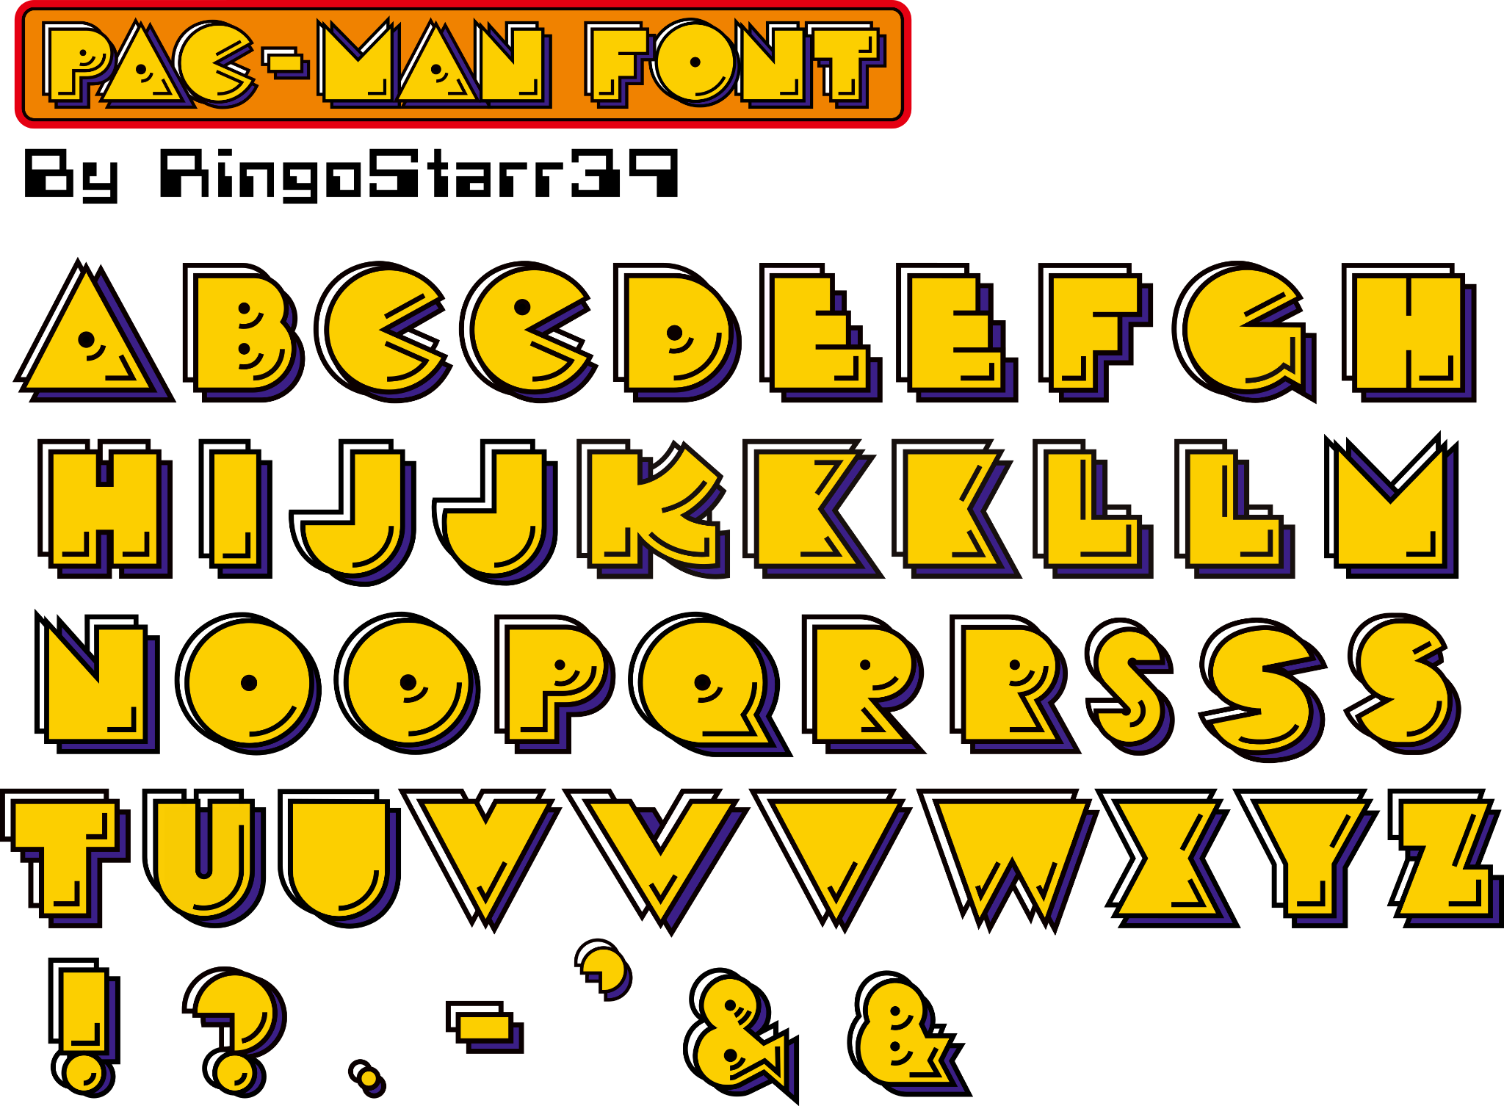
7. Fonts
The main font of the game, used for text, names and such, has a retro look of a RPG game. The letters resemble the style of the game which is pixel art and the main character.

Slide 11
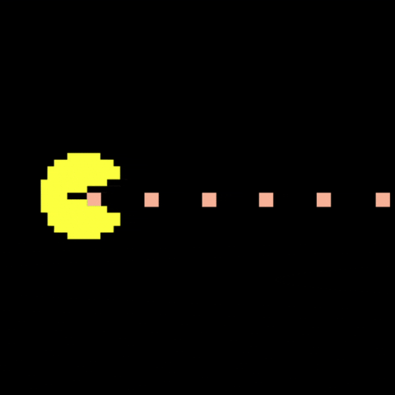
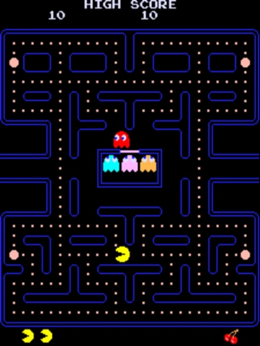
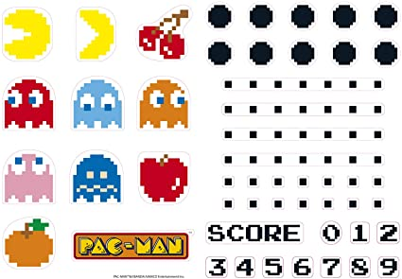
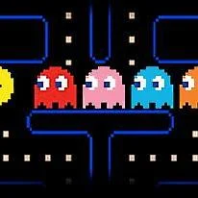
8. References

Slide 12
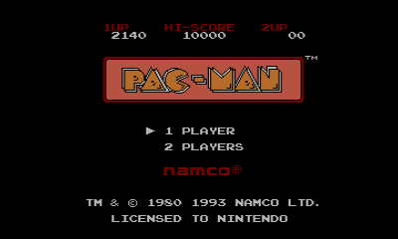
9. GUI references
The UI will follow a simple layout that helps the player understand his status, good objects, etc.

Slide 13
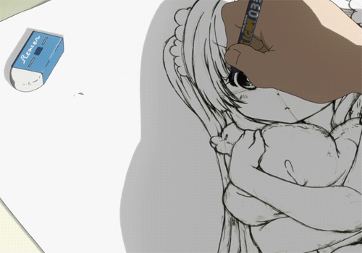
The end

